Slide 1
Power BI Embedded
FSI CSU SWARM

Slide 2
Introduction

Slide 3
Abstract and learning objectives
Abstract and learning objectives
Embed Power BI objects within applications

Slide 4
Embedding Functionalities
Embedding Power BI Content | The Power BI service (SaaS) and the Power BI Embedded service in Azure (PaaS) have APIs for embedding your dashboards and reports. This feature means you can access the latest Power BI features – such as dashboards, gateways, and app workspaces – when embedding your content.

Slide 5

Using the Power BI Service API
Accessible by making direct REST calls against service
Accessible by using assembly DLL that abstracts away REST calls
Assembly DLL is named microsoft.Powerbi.Api.Dll
Assembly DLL part of nuget package (microsoft.Powerbi.Api)
Calling service requires authentication with azure active directory

Slide 6
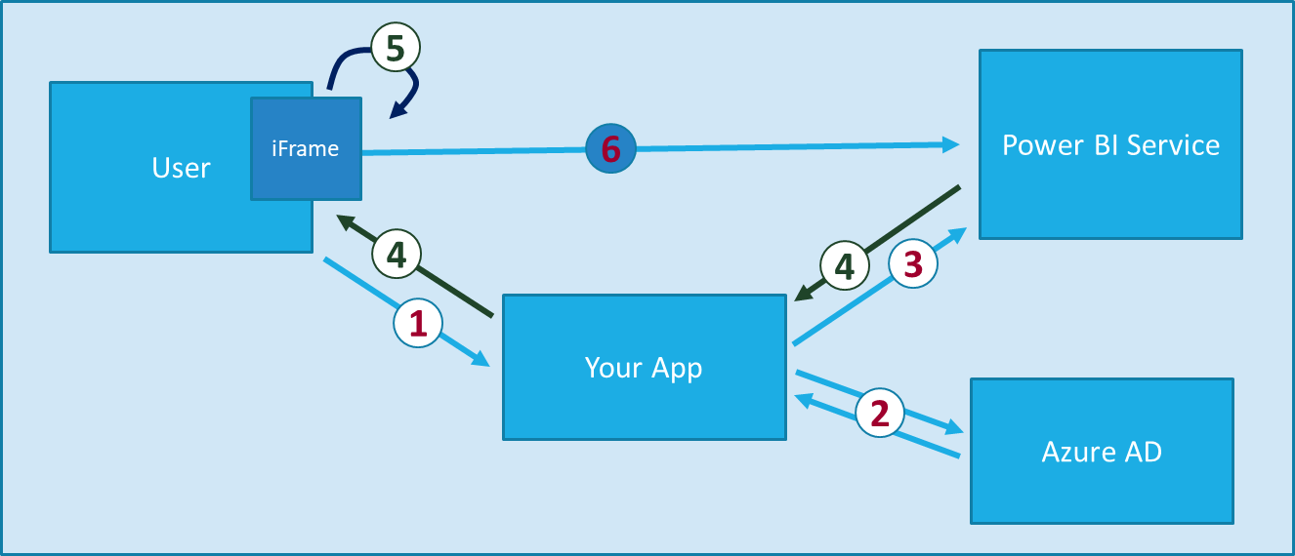
Power BI Embedding The Big Picture
User launches your app using a browser
App authenticates with azure active directory and obtains access token
App uses access token to call to power BI service API
App retrieves data for embedded resource and passes it to browser.
Client-side code uses power bi javascript api to create embedded resource
Embedded resource session created between browser and power BI service
Notes:
https://docs.microsoft.com/en-us/power-bi/developer/embedding

Slide 7
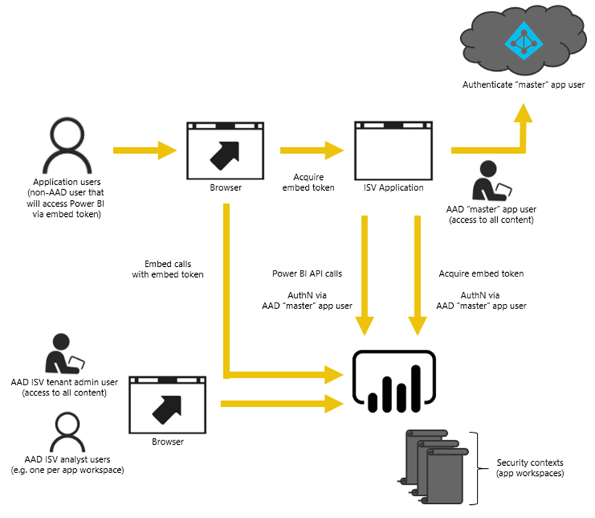
Power BI Embedding – The Big Picture
User launches your app using a browser
App authenticates with azure active directory and obtains access token
App uses access token to call to power BI service API
App retrieves data for embedded resource and passes it to browser.
Client-side code uses power bi javascript api to create embedded resource
Embedded resource session created between browser and power BI service

Slide 8
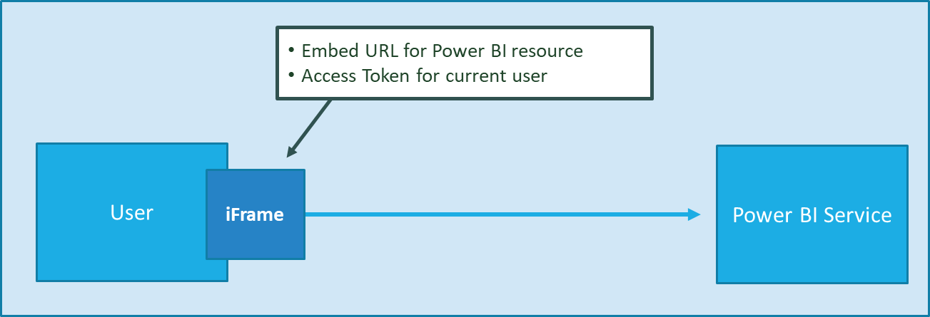
First Party Embedding
App authenticates current user with Azure AD
Your code accesses Power BI Service as current user
Embedding requires Azure AD access token for user
User requires Azure AD account and Power BI license
Your code has access to whatever user has access to

Slide 9
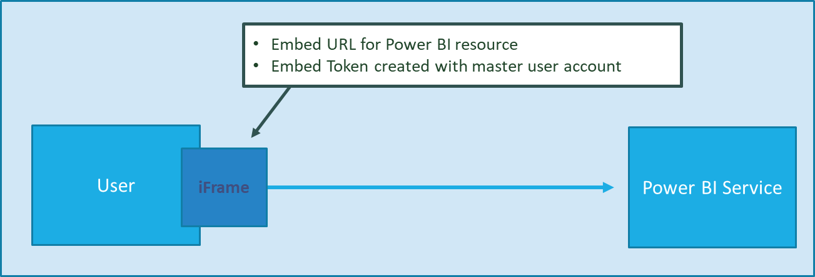
Third Party Embedding
App authenticates using Master User Account
Your code accesses Power BI Service as master user
Embedding uses embed token instead of access token
Users don’t need AAD accounts and Power BI licenses
Your code has access to whatever master has access to

Slide 10
First Party vs Third Party Embedding
What scenarios use first party embedding?
What scenarios use third party embedding?
Organizations where users have Power BI licenses
Embedding Power BI reports in SharePoint and Teams
Development should go beyond out-of-box experience
Scenarios where users don’t have Power BI licenses
Applications which have custom identity providers
Applications which use identity provider other than AAD

Slide 11
First Party vs Third Party Embedding Cont…
 | 1st Part Embedding | 3rd Party Embedding
Authentication flow | Authentication Code Grant Flow or Implicit Flow | Direct User Credentials
Identity used to call Power BI | Current User | Master User Account
Access to personal workspace | Yes | No
Access to app workspaces | Yes | Yes
Ability to reach non-licensed users | No | Yes
Supported Power BI Capacity SKUs | P* and EM* SKUs | P*, EM* and A* SKUs

Slide 12
Licensing

Slide 13
Licensing
How do I purchase Power BI Embedded?
What happens if I already purchased Power BI Premium and now I want some of the benefits of Power BI Embedded in Azure?
Power BI Embedded is available through Azure.
Customers continue to pay for any existing Power BI Premium purchases until the end of their current agreement term and then may switch their Power BI Premium purchases as necessary at that point.

Slide 14
Licensing
Do I still have to buy Power BI Premium to get access to Power BI Embedded?
What’s the purchase commitment for Power BI Embedded?
No, Power BI Embedded includes the Azure-based capacity that you need to deploy and distribute your solution to customers.
Customers may change their usage on an hourly basis. There is no monthly or annual commitment for the Power BI Embedded service.

Slide 15
Licensing
How does the usage of Power BI Embedded show up on my bill?
Who needs a Power BI Pro license for Power BI Embedded and why?
Power BI Embedded bills on a predictable hourly rate based on the type of node(s) deployed. As long as your resource is active, you are billed even if there is no usage. To stop being billed, you need to pause your resource actively.
Any developer that requires the use of the REST APIs needs a Power BI Pro license or service principal. Any analyst that needs to add reports to a Power BI workspace can either have a Power BI Pro license or use service principal. Any tenant admin that needs to manage the Power BI tenant and capacity is required to have a Power BI Pro license.
Because Power BI Embedded allows the use of the Power BI portal for managing and validating embedded content, the Power BI Pro license is required to authenticate the App inside PowerBI.com to get access to the reports in the right repositories.
However, for creating/editing embedded reports inside your application, the end user does not need a Pro license as the user isn't required to be a Power BI user at all.

Slide 16
FAQs

Slide 17
FAQs
What type of content pack data can be embedded?
What deploy regions are supported?
Dashboards and tiles that are built from content pack datasets cannot be embedded, however, reports built from a content pack dataset can be embedded.
Australia Southeast,
Brazil South,
Canada Central,
East US 2,
India West,
Japan East,
North Central US,
North Europe,
South Central US,
Southeast Asia,
UK South,
West Europe,
West US, and
West US 2.

Slide 18
FAQs
How can I monitor Power BI Embedded capacity consumption?
What is the Power BI Service?
Using the Power BI Admin portal.
Downloading the metric app in Power BI.
Using Azure diagnostic logging.
Provides cloud-based foundation for power BI platform
Accessible with browser through https://app.Powerbi.Com
Accessible through power BI mobile apps
Accessible to developers through power BI service API

Slide 19
FAQs
What is the PBI Embedded dedicated capacity role in a PBI Embedded solution?
What type of content pack data can be embedded?
To promote your solution to production, you need the Power BI content (app workspace that you are using in your application to be assigned to a Power BI Embedded (A SKU) capacity.
Dashboards and tiles that are built from content pack datasets cannot be embedded, however, reports built from a content pack dataset can be embedded.

Slide 20
FAQs
What is the authentication model for Power BI Embedded?
Power BI Embedded continues to use Azure AD for authentication of the master user (a designated Power BI Pro licensed user), or with service principal for authenticating the application inside Power BI.
The authentication and authorization of application users implemented by the ISV, the ISV can implement their authentication for their applications.
If you already have an Azure AD tenant, you can use your existing directory, or you can create a new Azure AD tenant for your embedded application content security.
To get an AAD token, you can use one of the Azure Active Directory Authentication Libraries. There are client libraries available for multiple platforms.

Slide 21
Wrap Up

Slide 22
Wrap-up
Outcome
Identify the preferred solution for the case study
Identify solutions designed by other teams
Timeframe
15 minutes

